Slide 1
HBase Introduction
Big-Table
Recommend Book:
HBase The Definitive Guide

Slide 2
HBase
A column-based database
Big-Table concept from Google
http://static.googleusercontent.com/media/research.google.com/zh-TW//archive/bigtable-osdi06.pdf
Always compared with another column-based database Cassandra developed by Facebook

Slide 3
Big-Table Column Family
RowKey + Timestamp => can search record
Very important
Table. UserInfo
RowKey (PK) Byte | Timestamp | Name | Info
 |  |  | Address | Phone | ID
User1 | T2 | Mark | XXXXX | 888888 | W123456
User2 | T1 | Mary | YYYYYY | 999999 | F123456
The table name: UserInfo
Row Key : UserID
Column Family: [Name, Info]
Column Family Qualifier: [Info:Address, Info:Phone, Info:ID]
HBase Command
Create ‘table_name’ 'column family1' , 'column family2‘
Put 'table name' , 'rowkey' , 'column family:qualifier' , 'value‘
Get ‘table name’, ‘rowkey’ [‘column family [: qualifier]’]
Delete ‘table name',‘rowkey', [‘column family [: qualifier]’]
Notes:
http://blog.csdn.net/scutshuxue/article/details/6988348

Slide 4
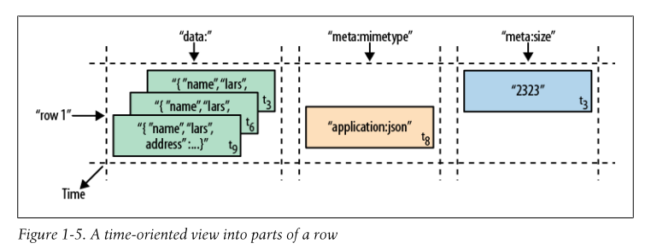
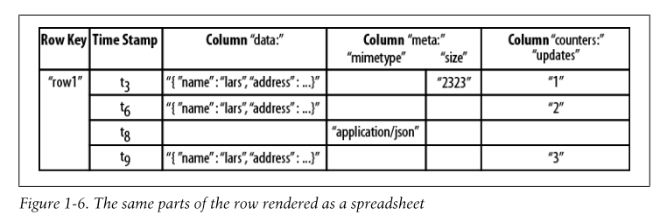
Column Family

Slide 5
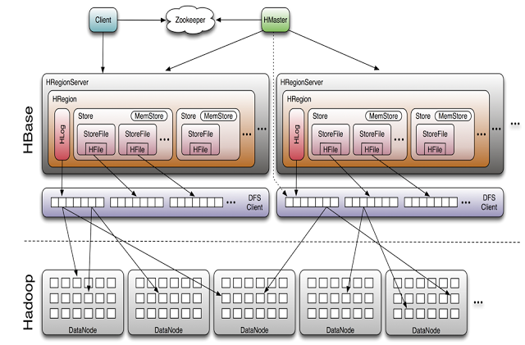
HBase Architecture
1. Master
2. Region Server
3. Region

Slide 6
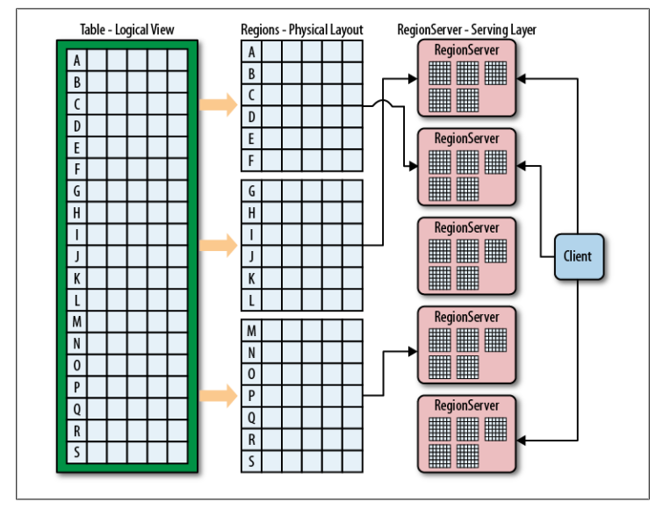
HBase Architecture
One table mapping to multiple regions
One Region can only be served by one Region Server
Each region attributed to which Region Server is controlled by Master (load balance)

Slide 7
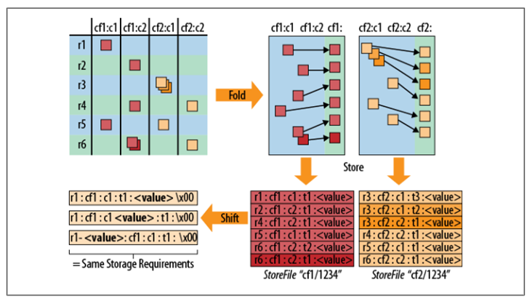
Region
Each Region contain a HLog (Write-Ahead Log, WAL)
For fail over use (Rolling Back)
Each Column Family generate a Store
Each Store contains a MemStore
Gain Performance
When MemStore over the threshold, flush to file (StoreFile(Hfile))
Each Region Contains multiple Hfiles
Each Region contains start row-key and end row-key

Slide 8
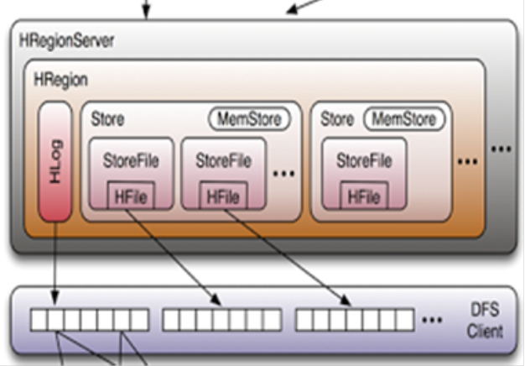
Region
When new data comes, write this data to HLog (remember this data sequence), and save this data in MemStore (Current this data not in disk)
If MemStore break down, re-launch regionserver, and rollback status from Hlog, and save this data in MemStore
If MemStore over flush threshold or region disconnect, flush data to disk(HFile remember this data sequence, current this data in disk)
MemStore flush data to StoreFile which saves in Hfile
When some of HLog unnecessary will change to OldHLog, because of data already saved

Slide 9
Master
Monitor cluster
Create/Delete/Alter tables
Region merge and split
Load balancing
Decide region attributes to which region server
Region server failover
If one region server failure, assign these regions to another region server

Slide 10
How clients find their regions?

Slide 11
How clients find their regions?
RowKey + Timestamp => can search record

Slide 12
HFile compression
Gzip
LZO (Lempel-Ziv-Oberhumer)
recommend
Snappy

Slide 13
HBase Web UI
Port 60010
Port 60030

Slide 14
Phoenix
Apache Phoenix is a relational database layer over HBase delivered as a client-embedded JDBC driver targeting low latency queries over HBase data
Just like SQL, very easy learning
http://phoenix.apache.org/language/index.html
http://phoenix.apache.org/performance.html

Slide 15
Thanks for your attention

